Slide 1
Day 3: Deep Learning & Final Projects
Mahmoud Abdelmoneum & Nicolas Stone
22 January 2025

Slide 2
Agenda
Deep Learning Lecture (30 minutes → 1:30pm - 2:00pm)
Finish Classification Exercise (60 minutes → 2:00pm - 3:30pm)
Project Discussion (15 minutes → 3:30pm - 3:45pm)
Final Project Work Time (60 minutes → 3:45pm - 4:00pm)

Slide 3
Section I: Deep Learning!

Slide 4

Has anyone here heard about deep learning? If so, what do you think it is?

Slide 5
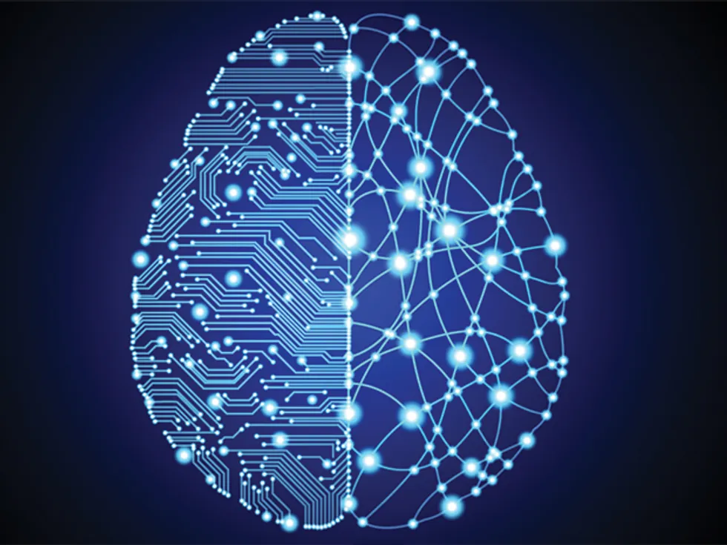
Deep Learning: The field of machine learning concerned with replicating the method by which the brain makes predictions to perform more sophisticated reasoning

Slide 6
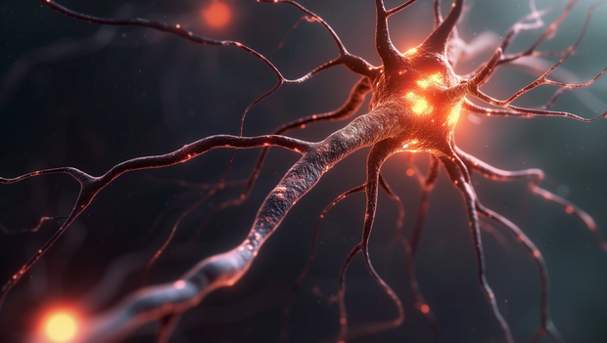
Basics of human reasoning: The neuron
The brain is made up of cells called neurons
When a neuron is stimulated enough, it “turns on” by firing
Neurons are stimulated by the firing of nearby neurons
Different patterns of firing and stimulation between neurons gives way to organisms’ ability to think

Slide 7
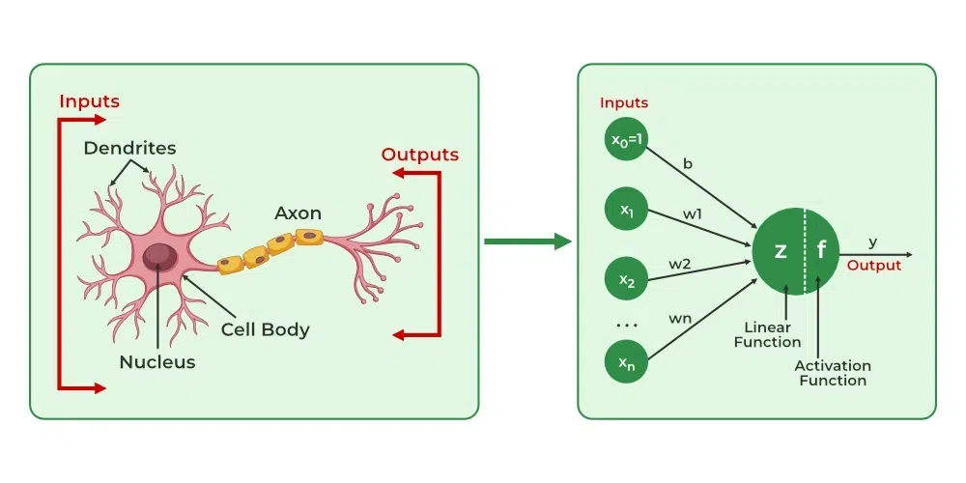
Deep Learning: The neuron
Deep learning is based on the idea of artificial neural networks
These are mathematical replicates of networks of neurons
The math is a bit complicated, but we can basically programmatically create artificial “neurons” that “fire”, or pass on information to the next neuron if the number input to them is sufficiently large

Slide 8
What makes a neural network so useful?
ML aims to pick up patterns from data
As we saw from our previous sections on regression and classification, these patterns often take the form of shapes in sets of data, called distribution
Classical, non-deep learning ML techniques make an assumption about the shape before hand, so are restricted (e.g linear is a straight line, logistic is an S-shaped curve, etc.)
Neural networks are what we call universal approximators–they can learn any shape without a previous description

Slide 9
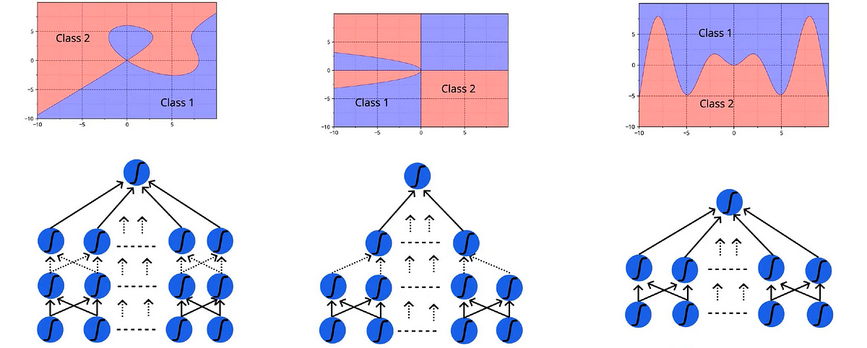
Neural Networks As Universal Approximators

Slide 10
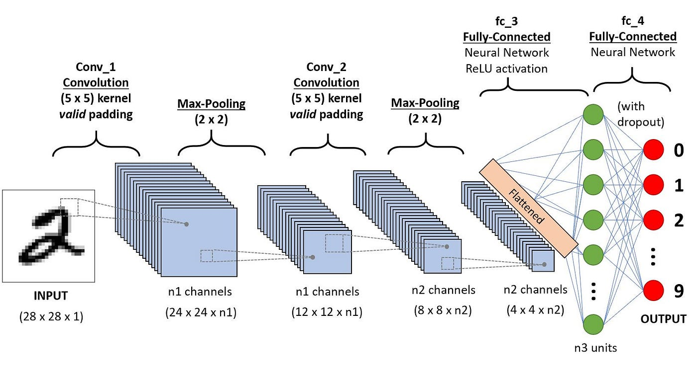
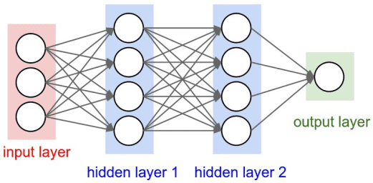
There are many different kinds of neural networks!
Feed Forward Neural Networks (FFNNs): good for regression and classifications with numbers
Convolutional Neural Networks (CNNs): good for image or sound related tasks
CNNs
Feed Forward Neural Networks

Slide 11
Take 15 minutes to do some research with your groups: What are some cool examples of technologies that use deep learning?
Challenge question: what kind of neural networks do they use?

Slide 12
Learning Deep Learning (DL)
We will not do a deep learning exercise (pretty advanced)
But if you are interested/comfortable, we encourage you to explore!
Implementation:
Coding Implementation: How do we write code for DL? Libraries!
Main library to learn: Pytorch → becoming dominant in the field of ML
Other Libraries: Tensorflow or Numpy (if you want to go back to the stone age)
Good tutorials:
Datacamp (one of many good tutorials they have): https://www.datacamp.com/tutorial/deep-learning-python
GeeksForGeeks: https://www.geeksforgeeks.org/deep-learning-tutorial/
Kaggle: https://www.kaggle.com/code/kanncaa1/deep-learning-tutorial-for-beginners
Theory:
Learn advanced math!
Awesome comprehensive math for machine learning for beginners tutorial: https://www.youtube.com/watch?v=MDL384gsAk0&ab_channel=Weights%26Biases
Basic derivative calculus (Khan Academy: https://www.khanacademy.org/math/calculus-1)
Basic linear algebra (3Blue1Brown: https://www.youtube.com/playlist?list=PLZHQObOWTQDPD3MizzM2xVFitgF8hE_ab)
Probability (Khan Academy: https://www.khanacademy.org/math/statistics-probability/probability-library)

Slide 13
Section II: Classification Exercise Wrap Up

Slide 14
Classification Exercise: Details
See End of Day 2 Slides In GDrive For Instructions!

Slide 15
Note: Independent Learning Tools I Love
Versatile Coding, debugging, question/answers: ChatGPT
Internet Search:
perplexity.ai (AI powered internet search)
Google (traditional internet search)
Building Coding Knowledge:
Code Library Documentation (for this project scikit-learn docs → https://scikit-learn.org/)
Geeks for Geeks (helps with all around coding in many languages → https://www.geeksforgeeks.org/)

Slide 16
Get To Work!

Slide 17
Section III: Project Discussion

Slide 18
Project Guidelines
5-7 minute group presentation of either your classification or regression exercises work before your renewable energy proposal
Presentation elements:
Choose of the two exercises you did this week (classification or regression) to use for our final presentation
Introduce the problem your model solved
Describe whether your model is supervised or unsupervised
Describe if your problem is classification or regression
Describe the data that you used (its features, where you could possibly find it in real life, any issues you see with it, etc.)
Present the figures you produced, explain what they show
Explain your classification accuracy or mean squared error
Explain the steps you took to get these results (at a high level explain what coding language you used, what libraries you used, the different steps of your code, etc.)
As a conclusion, describe whether your results were good or bad, limitations of your project, and how you could improve this project in the future or apply these skills to new renewable energy/sustainability problems
We expect you to understand the content you are presenting thoroughly; If you read off your slides or copy everything from GPT, we will know, and you will get poor marks!

Slide 19
Instructions For Work Session
While you might each have independent exercise code, you will be presenting as a group → come together to determine which person has the best code/figures; use this one for your presentation (or possibly a combination of the figures)
Right now: make your slides, practice your 5-7 minute presentation

